Slide 1
RoboCat- Milestone 2
ALEX VILD, QUINTIN FETTES, ZACH TAYLOR, KURTIS DAVIS, SEATTLE RUZEK, LUKE SHAYS

Slide 2
System Architecture
RoboApp is written using AndroidSDK
The code within the project is written in Java and Matlab. We will mainly be using the Java code.
The app is deployed to the phone, then the phone, with the app running is connected via usb to the cat and mounted on the cat to serve as its “head.”
There are 4 main modules: Face Tracking, Color Tracking, Speech Recognition, and Environmental mapping.
See Diagram next slide
Notes:
Present

Slide 3
RoboApp
Android Studio
Face Tracking
Color Tracking
Speech Recognition
Environmental Mapping
Google Play Services
PocketSphinx
http://cmusphinx.sourceforge.net/
Servos
Arduino

Slide 4
Release Process
From beginning to end:
A developer will clone a branch of the repo
Make improvements to the functionality of the cat
Test branch code on the RoboCat
Merge branch with master upon successful test
At each milestone, mark a release on github. Develop apk and upload to Google Play Store
Not uploaded to store right now. We need the account info
Notes:
Present

Slide 5
Bug Reporting Channel
All done via github issues

Slide 6
Alternative Technologies
Google Play services (Vision)
this was used in lieu of openCV. It’s simpler, better supported, and more maintainable
Used for face tracking and Color Tracking
PhotoSphinx
used in addition to google API for speech. Continuous listening is not possible with only Google’s API

Slide 7
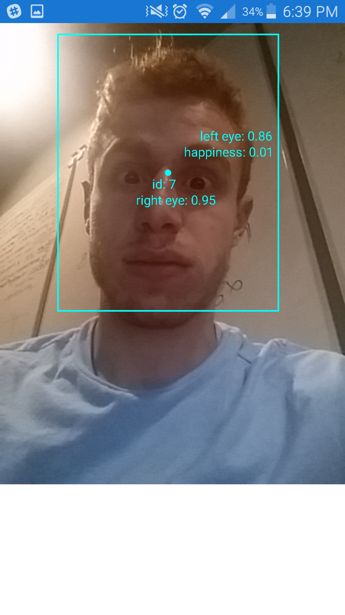

Build 2- What’s new?
Notes:
Don’t present - show late

Slide 8
Original Milestones
Our team was given 3 major goals for improvements to the RoboCat:
Active Speech Recognition
Facial Recognition and Tracking
Environmental Mapping
Initially, our plan was to split into 3 groups of 2 so that we could address these project requirements, with each team of 2 having sub-milestones at each group milestone.
Notes:
Present

Slide 9
Original Milestone 1 (From Sprint 1)
Group
Debug app to the point that it will compile and run on android devices
Perform a test of the current functions of the Robocat
Document and Organize Git repository
Notes:
Present

Slide 10
Original Milestone 1 (From sprint 1)
Speech Recognition Team
Document and test the accepted commands for the cat
Facial Recognition Team
Test the color tracking functionality; evaluate issues with this functionality
Environmental mapping team
Decided on a new hardware component to add to the RoboCat to assist in Environmental mapping - ultrasonic sensor.
Notes:
Present

Slide 11
Original Milestone 2 (From sprint 1)
Speech Recognition Team
Overall improved accuracy of speech recognition
Continuous listening, prompted by a keyword for commands
Facial Recognition Team
Recognize a face or faces in the environment
Recognize a user specified color in the environment
Environmental Mapping Team
Establish Communication between the Arduino board, the new hardware, the servos controller, and the phone.
Add a battery indicator using the GUI of RoboApp
Decide a method for communication between both an Arduino Board and the servos controller (whether it can be parallel or communication between servos and phone has to run through the Arduino Board
Determine how accelerometer data is logged.
Notes:
Present

Slide 12
Original Milestone 3 (From sprint 1)
Speech Recognition Team
Accurate recognition of all existing commands; additional command will be added
Begin implementing emotion detection based upon volume/tone of voice
Facial Recognition Team
The cat will be able to move its head to center a recognized face in its field of view
the head to center on will periodically be randomly chosen from all recognized faces
The cat will be able to move its head to center a recognized color in its field of view
Environmental Mapping team
The cat will begin mapping the room based on his distance from surrounding objects
Determine how to output the map that he has made observed.
Notes:
Present

Slide 13
Original Milestone 4 (From sprint 1)
Speech Recognition Team
Fully implement Emotion detection via sound/tone of voice
Facial Recognition Team
Basic emotion detection based upon the facial expression in a detected face will be implemented; at the least, the cat will recognize happiness and anger
Environmental Mapping Team
The cat will be able to accurately map its surroundings in an unknown environment. The cat can’t currently walk, so the testing of this will be limited.
Log accelerometer data.
Notes:
Present

Slide 14
New Milestone 2
Speech Recognition Team
Added menu button
Added new voice command
Tell the user when a command is not recognized
Attempted to implement pocketsphinx for active listening of commands
Added command to make the cat cry.
Added command to make the cat disgusted with us
Facial Recognition Team
Recognize multiple faces in the environment
track the position of faces in the environment
detect emotion in faces (from original milestone 4)
track a color in the environment
track the position of color in the environment
Notes:
Present

Slide 15
New Milestone 2
Environmental Mapping Team
Log accelerometer data to the Android Monitor to track the movement of the phone.
Created standalone app that tracks battery information that will later be integrated into the main RoboApp. The battery information will be used to ultimately influence the cat behavior/mood.
Notes:
Present

Slide 16
New Milestone 3
Speech Recognition Team
Active listening using PhotoSphinx
found to be impossible using only Google Play Services
Allow Voice Commands to work with servos motors
Facial Recognition Team
Begin coding to all the cat to move its head to center a recognized face in its field of view
This functionality will be completed in Milestone 4
Integrate Color Tracking standalone app into RoboApp
remove all openCV code from app
Environmental Mapping team
Send and receive data to and from the phone to the arduino board
integrate standalone battery indicator into RoboApp
Notes:
Present

Slide 17
New Milestone 4
Speech Recognition Team
Find some way to get waveform or volume data via constant listening
Get cat to respond to loud noises
Facial Recognition Team
Full ability to move head to track faces and colors
responses to emotion detected in faces implemented
Environmental Mapping Team
Develop map of the cat’s surroundings based on the distance data gathered by the ultrasonic sensor
Notes:
Present

Slide 18
Individual Contributions: Milestone 2
Speech Recognition Team:
Alex:
Added menu button
Added new voice command
Tell the user when a command is not recognized
Attempted to implement pocketsphinx for active listening of commands
Kurtis:
Added command to make the cat cry.
Added command to make the cat disgusted with us.
Notes:
Present

Slide 19
Individual Contributions: Milestone 2
Facial Recognition Team:
Quintin
Initially, added a standalone app to track faces, track eye position, and detect happiness by mouth shape and eye position
This app is implemented entirely using google play services
Later, Integrated this app into Roboapp. This functionality is now available via the developer menu and a voice command
several changes were made to the code from the standalone app
it will not passively track faces until we are sure the head movements associated with it are safe.
Notes:
Present

Slide 20
Individual Contributions: Milestone 2
Facial Recognition Team:
Lukas
Created standalone app to begin implementing color tracking, to be added to Robocat app later on.
Notes:
Present

Slide 21
Individual Contributions: Milestone 2
Environmental Mapping Team:
Seattle:
Log accelerometer data to the Android Monitor to track the movement of the phone.
Zach
Created standalone app that tracks battery information that will later be integrated into the main RoboApp. The battery information will be used to ultimately influence the cat behavior/mood.
Notes:
Present

Slide 22
Individual Responsibilities: Milestone 3
Speech Recognition Team:
Alex:
Implement active listening, either via pocketsphinx or some different method
Kurtis
Add developer option to display the text version of speech commands, so that the user can see what the cat heard
implement continuous voice recognition
debug mapping of voice command to actions
Figure out if there are any crucial commands our client wants added so we can add them in.
Notes:
Present

Slide 23
Individual Responsibilities: Milestone 3
Facial Recognition Team:
Quintin
Begin implementing head movement to accompany facial recognition
Also begin implementing response to perceived happiness of tracked faces.
Both of these steps are not expected to be fully implemented until milestone 4
remove all openCV code from app
Lukas
Integrate the Standalone color tracking app with Roboapp
begin implementing head movements to track
Notes:
Present

Slide 24
Individual Responsibilities: Milestone 3
Environmental Mapping Team
Seattle
Arduino to Servos connection.
Zach
integrate battery information into main RoboApp
Receive distance measurement data from the ultrasonic sensor.
Notes:
Present

Slide 25
Our new MVP
Our MVP did not change! Our current goals still go far beyond the MVP
Requirements
Continuous Voice Recognition for existing commands
Color Tracking ability
Face Tracking ability
Environmental mapping: functioning sensor and mapping. The cat can’t walk, so functionality will be slightly limited
Log accelerometer data
Add Battery indicator
We will deliver an application that is far more manageable and sustainable than what was given to us and former groups before us, with clean and descriptive documentation and code.
We will meet and exceed these goals according to our schedule!
Notes:
Present

Slide 26
Use cases
Face Tracking Mode
cat identifies a face and centers it in its field of view
Color Tracking Mode
cat identifies a color and centers it in its field of view
All Modes
Cat listens for voice commands
Cat maps its environment using ultrasonic sensor

Slide 27
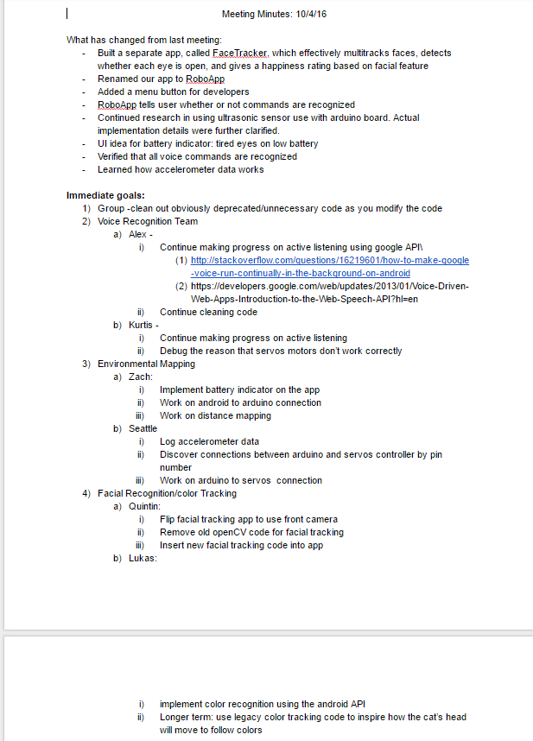
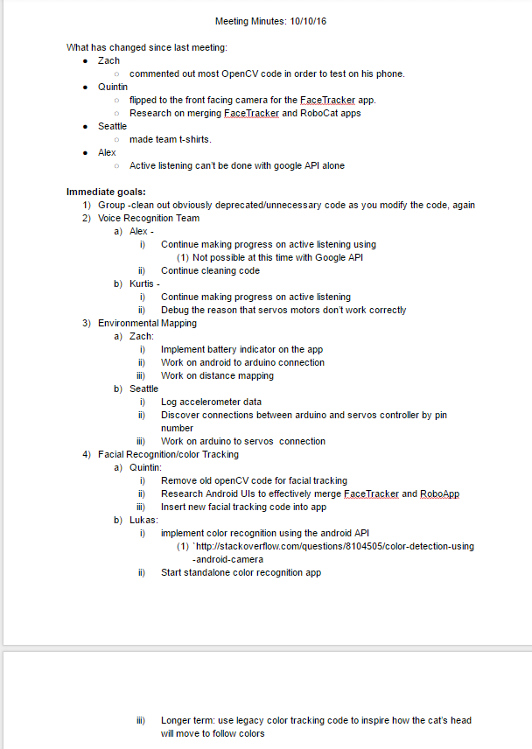

Slide 28
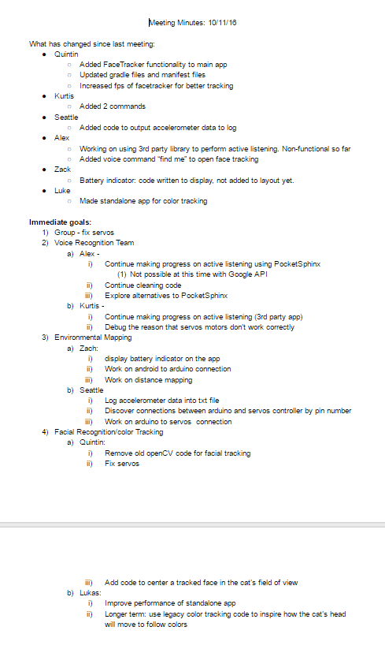
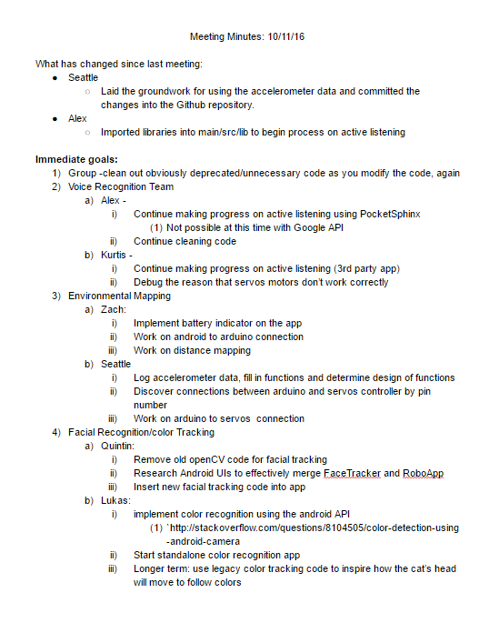

Slide 29
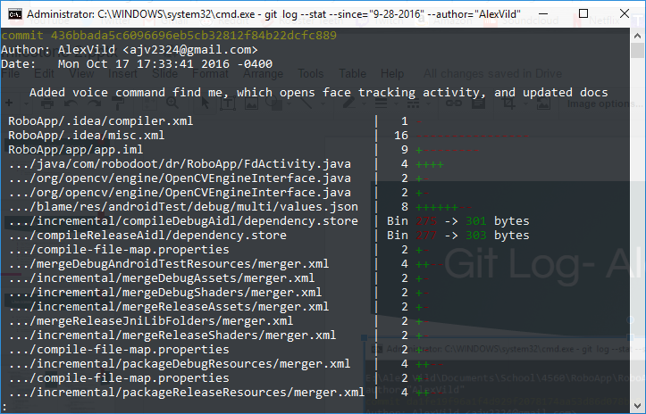
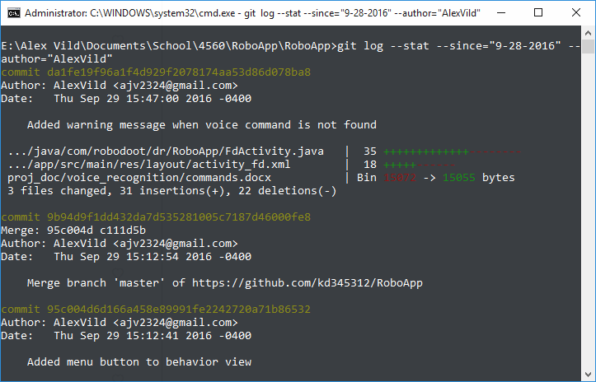
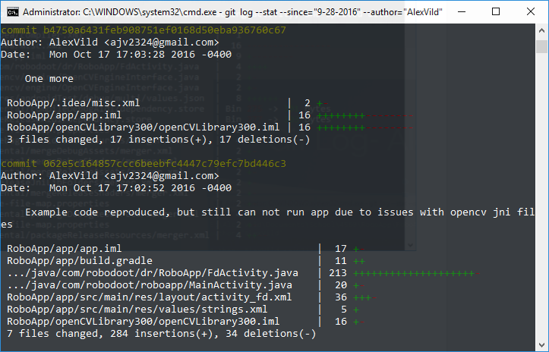
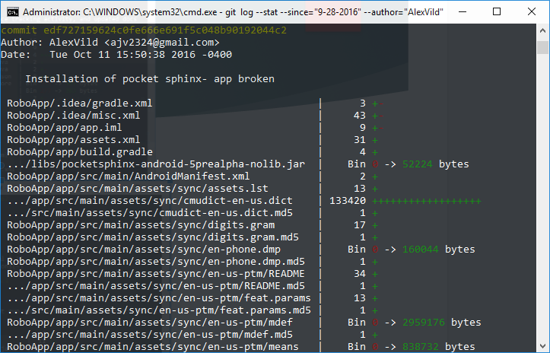
Git Log- Alex

Slide 30
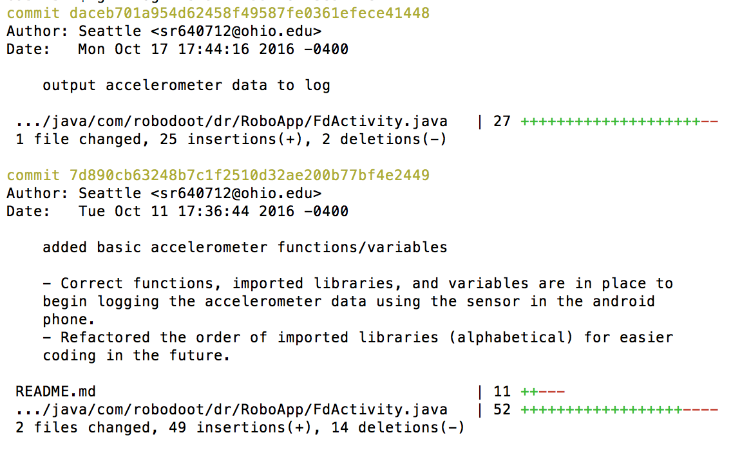
Git Log- Seattle

Slide 31
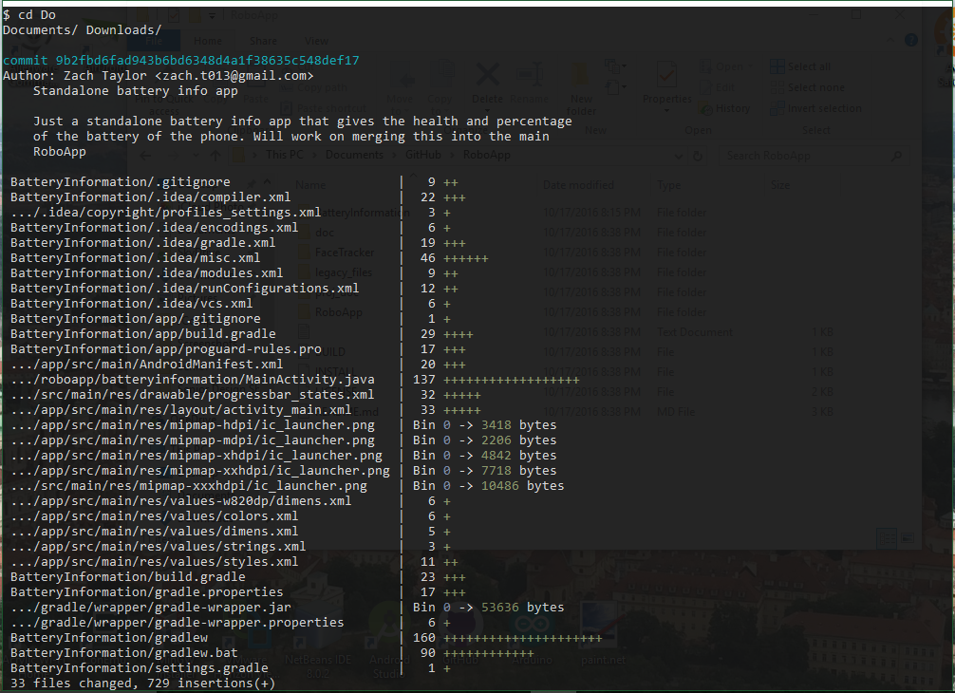
Git Log- Zach

Slide 32
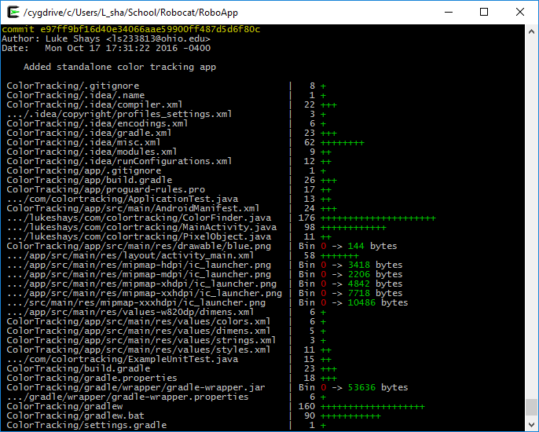
Git Log- Luke

Slide 33
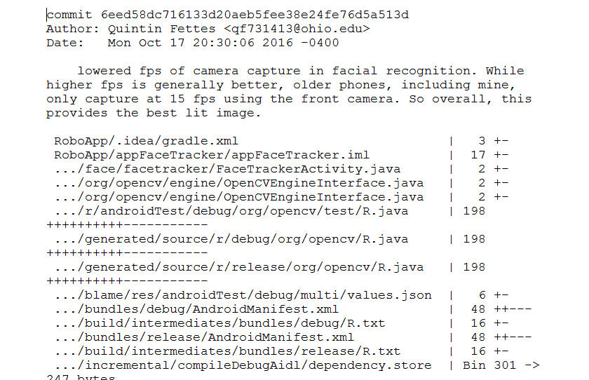
Git Log- Quintin (only most recent, others included in submit)

Slide 34
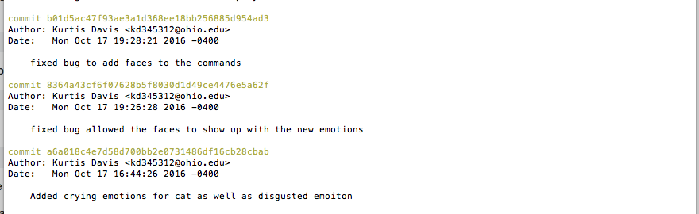
Git Log- Kurtis

Slide 35
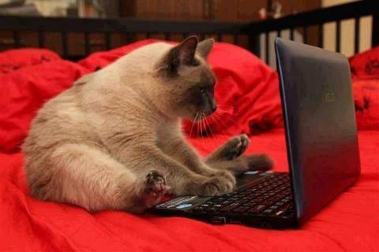
RoboCat Project
Notes:
Introduce ourselves

Slide 36
Demo
Voice Recognition Demo
Color Tracking Demo
Battery Indicator Demo
Facial Tracking Demo

